Slide 1
ORNL Neutron Sciences Update
Garrett E. Granroth
Neutron Data Science Group Lead
Neutron Scattering Division

Slide 2
Updates
Inner reflector plug change out at SNS
SNS Target Bubble Injection
Major Upgrade for POWGEN
New detector on WAND at HFIR
File system replacement
PyVdrive
3D-ΔPDF
Automated normalization and Slicing on HySpec

Slide 3
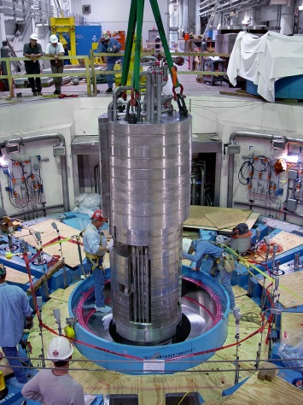
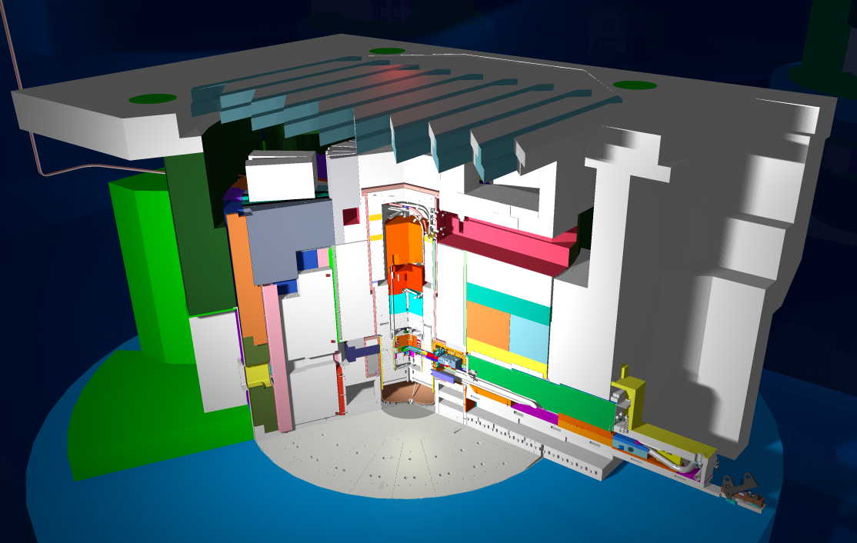
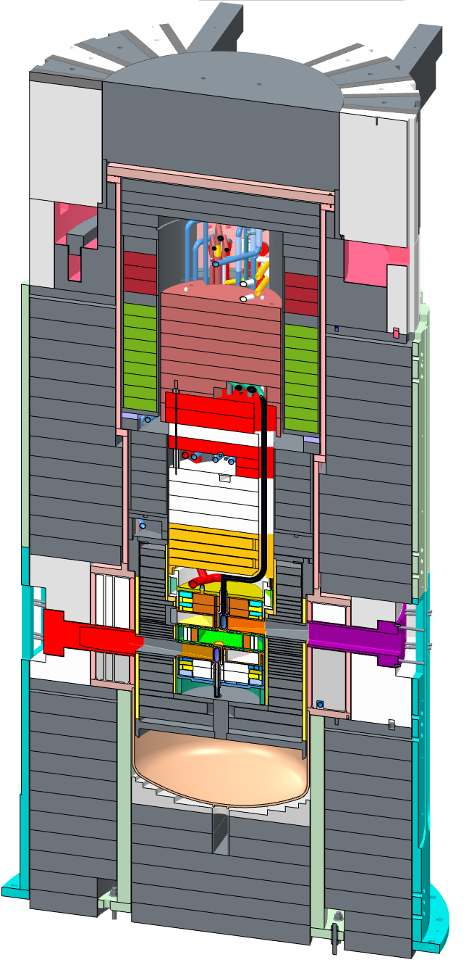
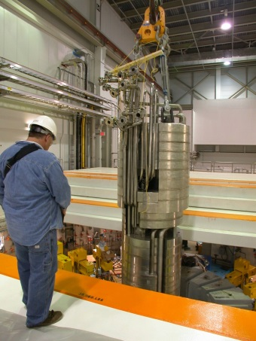
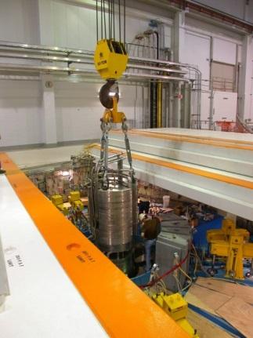
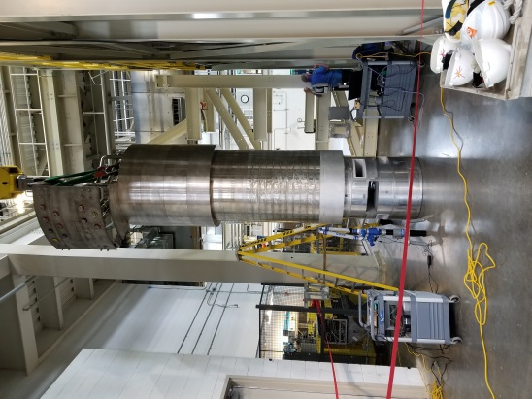
The ~32-ton Inner Reflector Plug (IRP) shields, reflects, and moderates the neutrons created in the mercury target, and channels them to the beam lines
Inner Reflector Plug
Outer Reflector Plug
Core Vessel
Insertion of the current IRP (twice) during SNS construction (above), and the new IRP undergoing receipt metrology inspection prior to testing in the Mock Up Test Stand (right)
Proximity of workers shown in the installation pictures will not be possible for the planned replacement work.
Bulk shielding
The IRP is installed in the Core Vessel and Outer Reflector Plug (ORP) assembly. The top of the core vessel is accessible from the Bldg. 8700 High Bay.

Slide 4
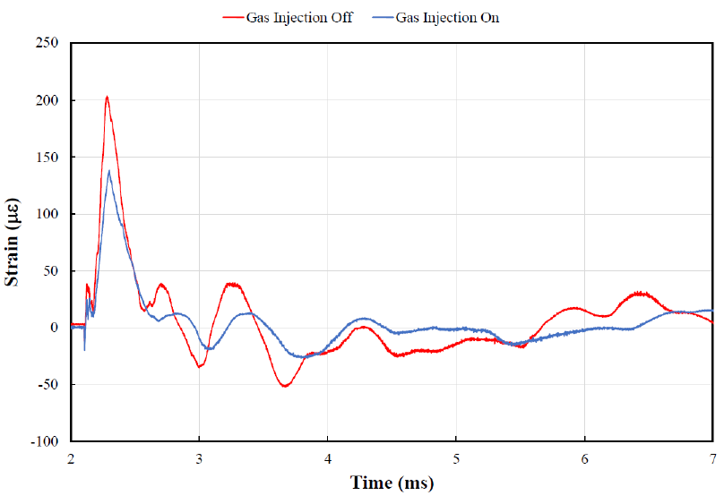
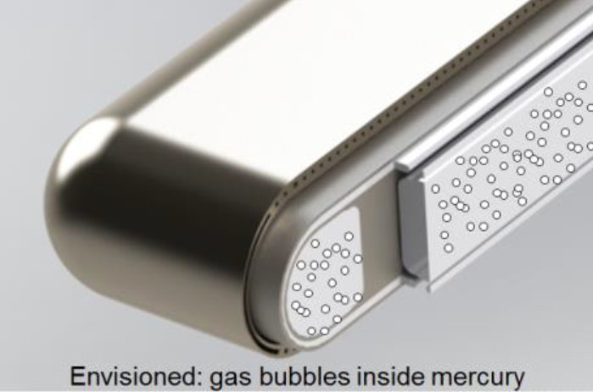
Gas Injection Reduces target strain
Gas injection into liquid Hg reduces strain
Reduced strain means less pitting and fatigue
Less pitting and fatigue means longer lifetime at higher powers.
Path to 1.4 MW and then on to 2 MW

Slide 5
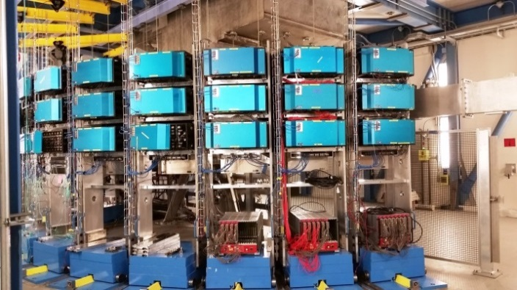
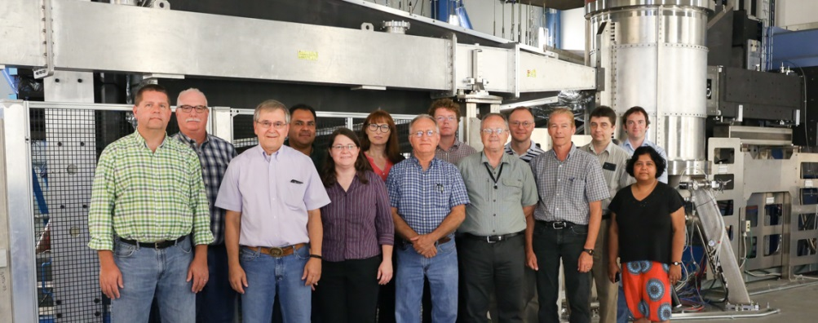
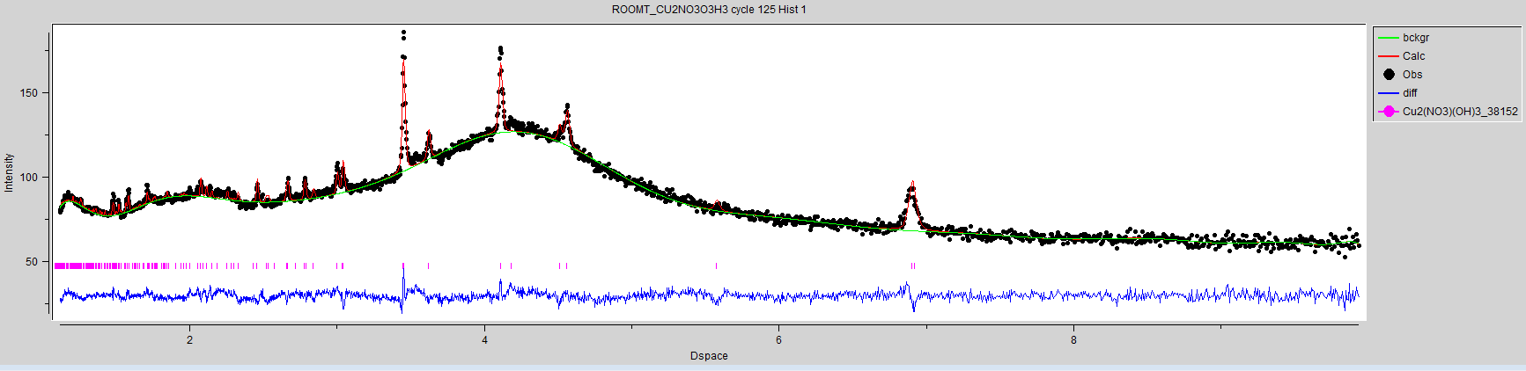
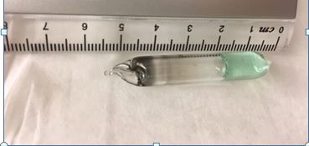
Powgen Upgrade
Expected increase in throughput ~1.5 (~30% additional detector coverage) + 1.2MW operation
Possible to measure smaller sample (more difficult experiments).
Figure shows a Rietveld refinement of 300mg sample in a deuterated solvent and quartz ampule inside a V can. The data collection time ~ 1 hour. The goal of the project is to follow synthesis of new phases.

Slide 6
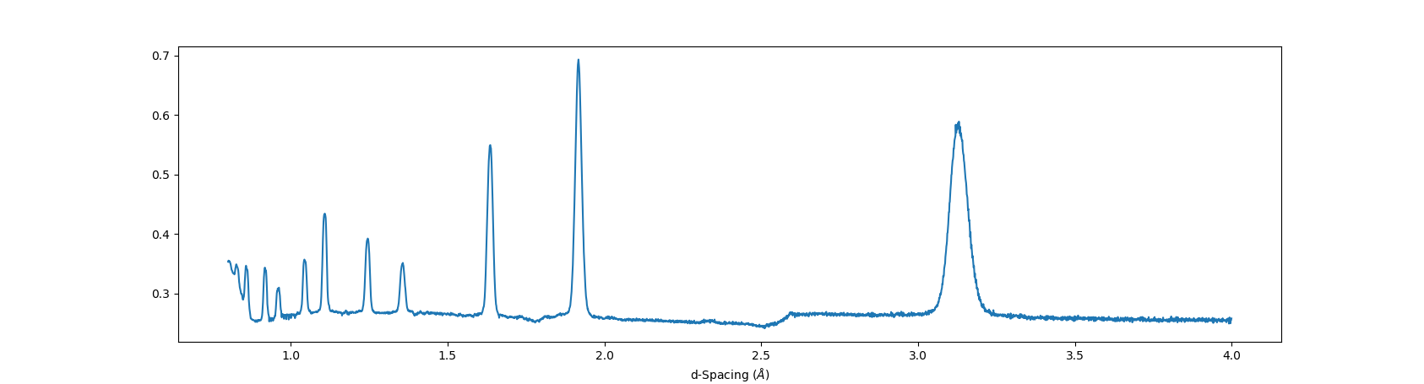
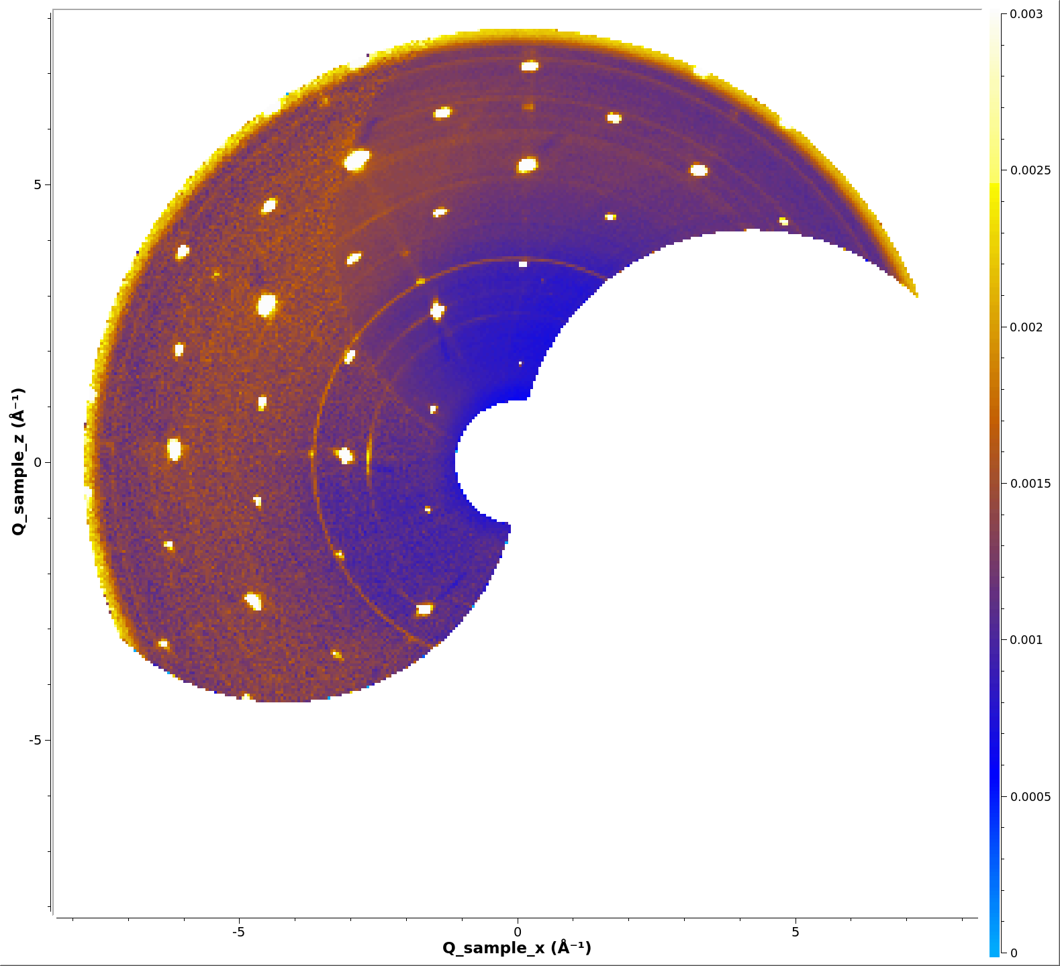
Continuous highly pixelated detector added to WAND
Data collection via EPICS-based system
Test sample data collected and reduced
Si powder reduced to d-spacing
Single crystal (Ho₂PdSi₃), collected in 0.1° step rotation, 0.05 thick slice in Q.
Commissioning is under way.
Overview screen for the WAND instrument in EPICS/CSS during a recent commissioning run.

Slide 7
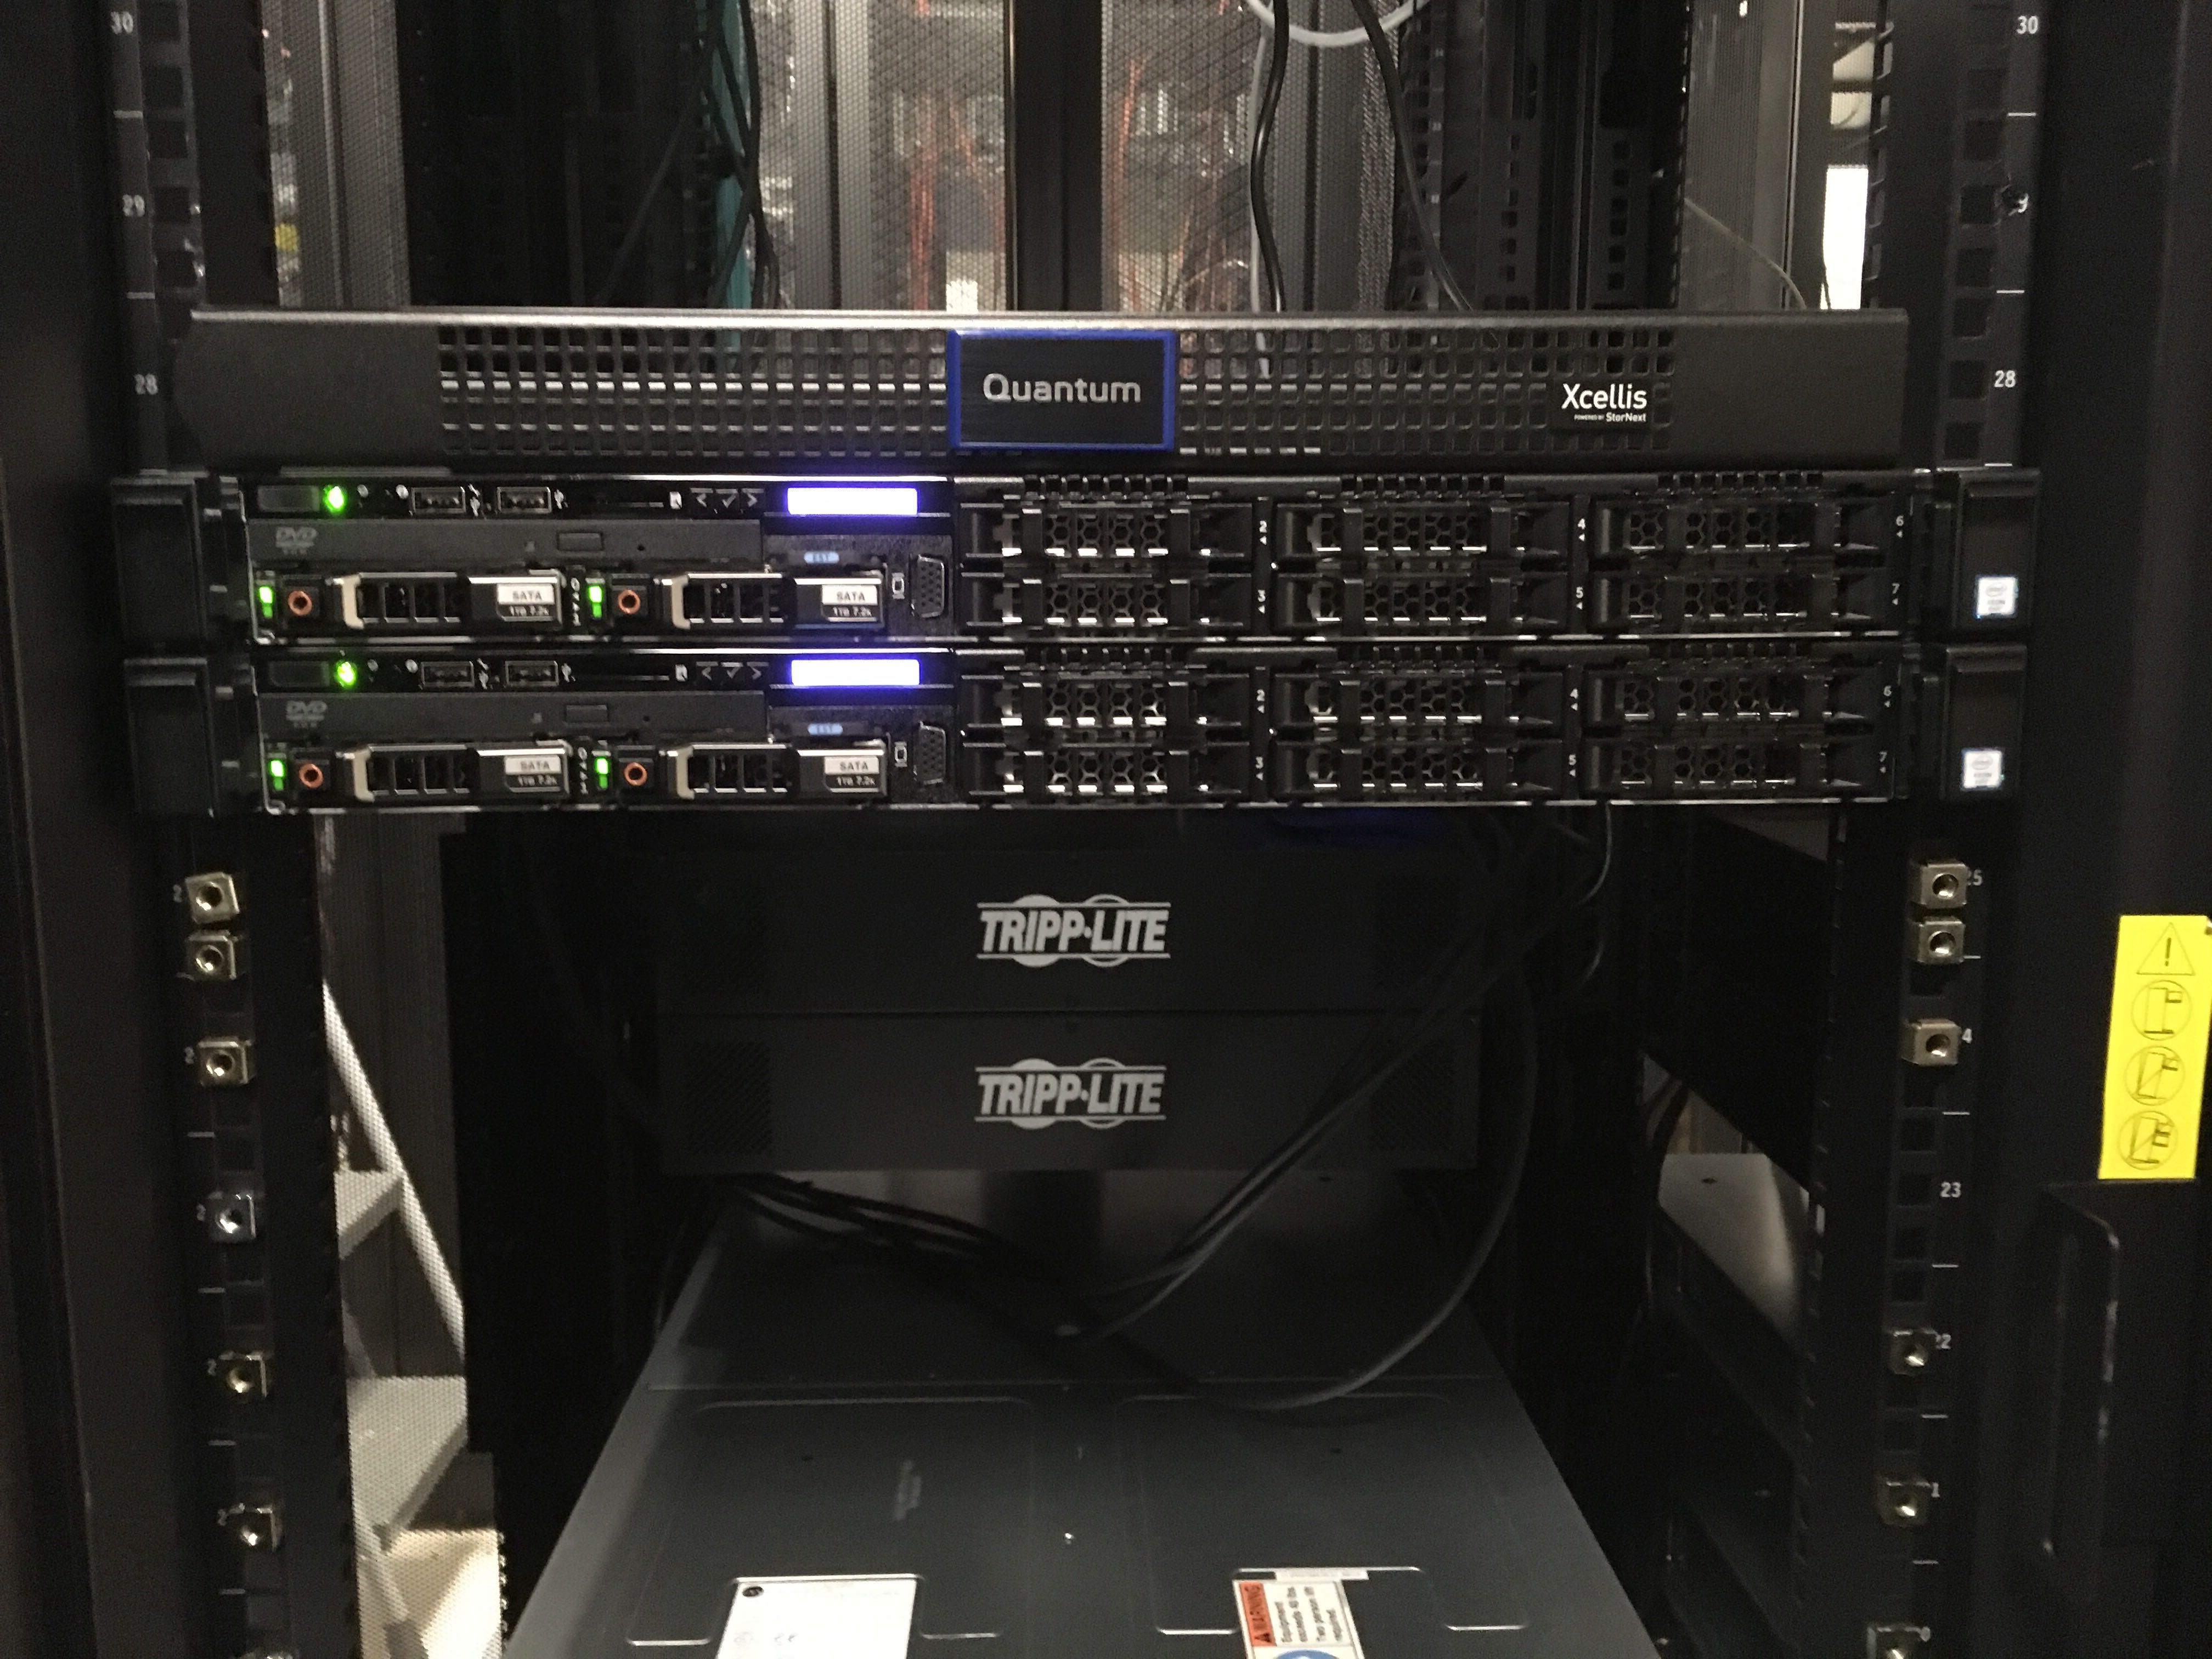
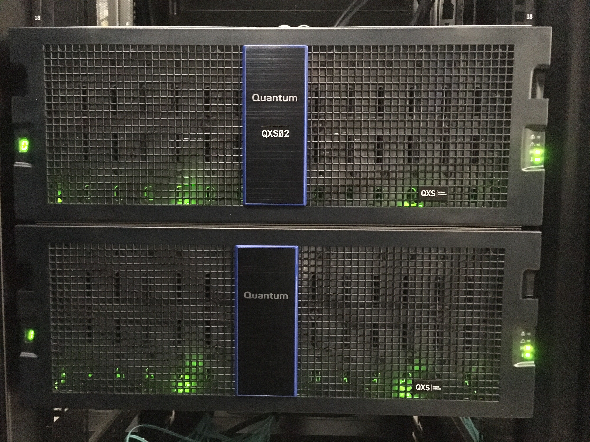
Upgraded Filesystem
Improves access performance for typical user experiment workflows
2.2 petabyte file system for neutron scattering
Doubles the online storage capacity
Received and installed.
Undergoing acceptance testing and commissioning.
It is targeted to be the primary data storage beginning with the next SNS run cycle.
A portion of the new file system hardware installed in the SNS server room.

Slide 8
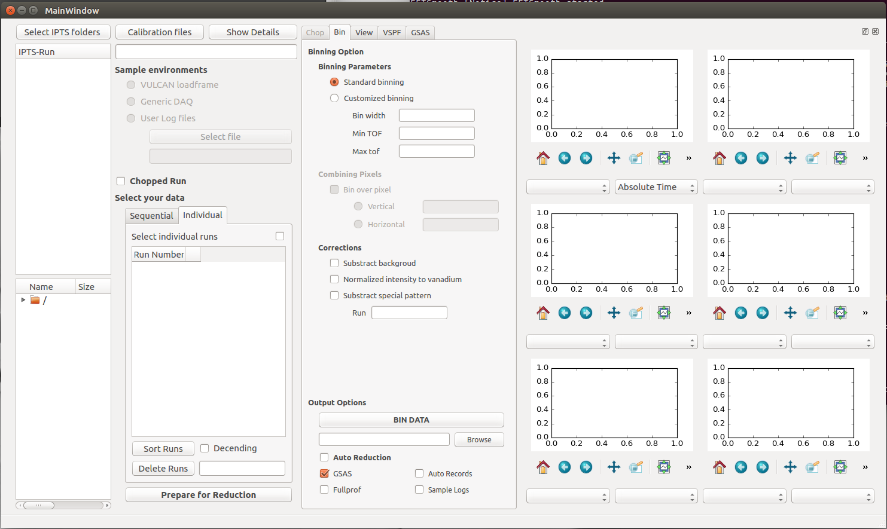
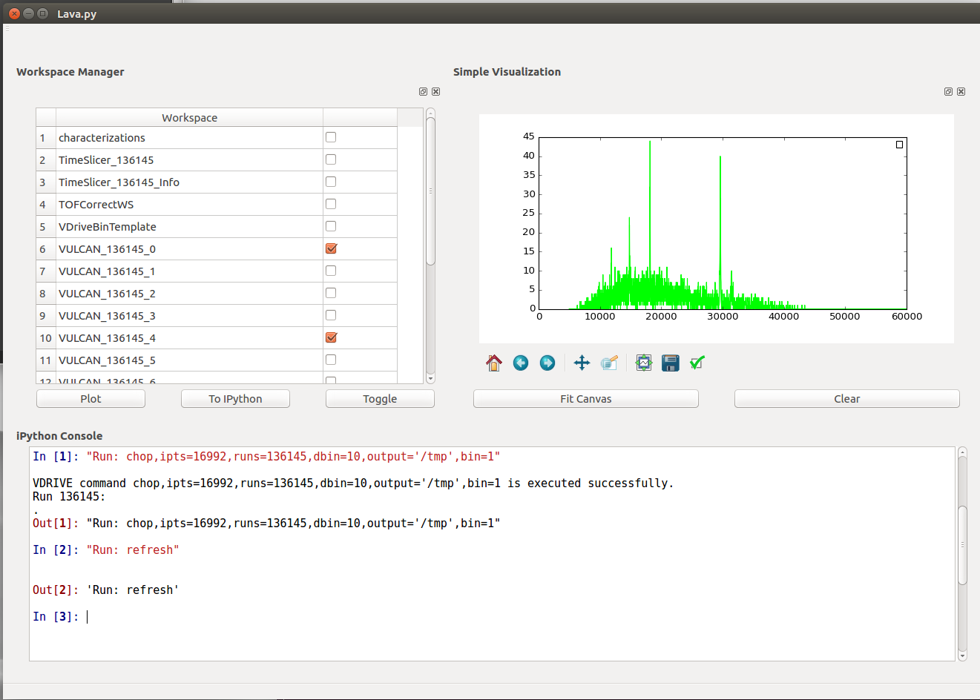
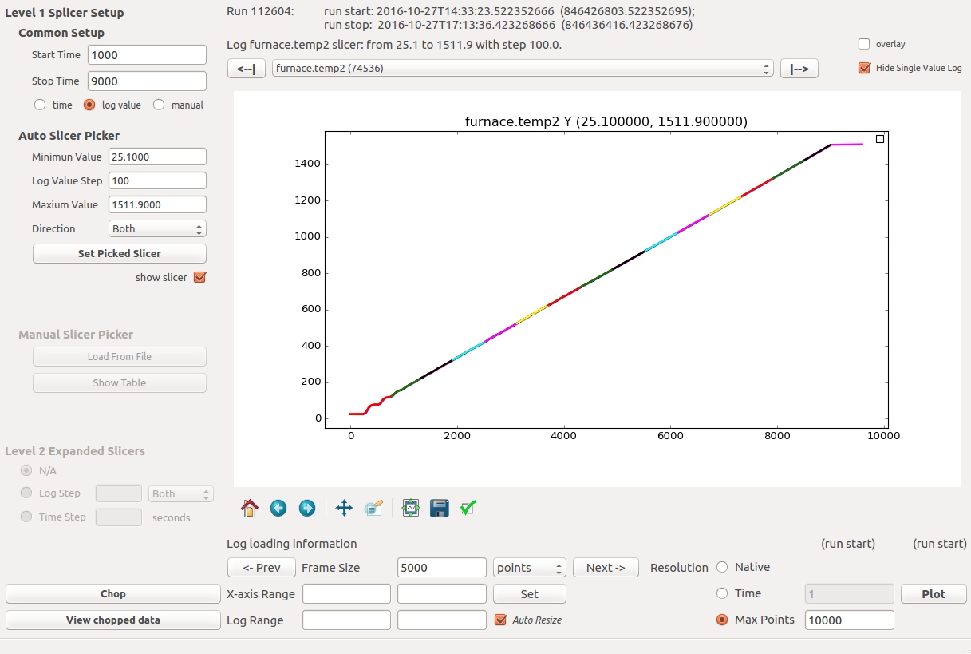
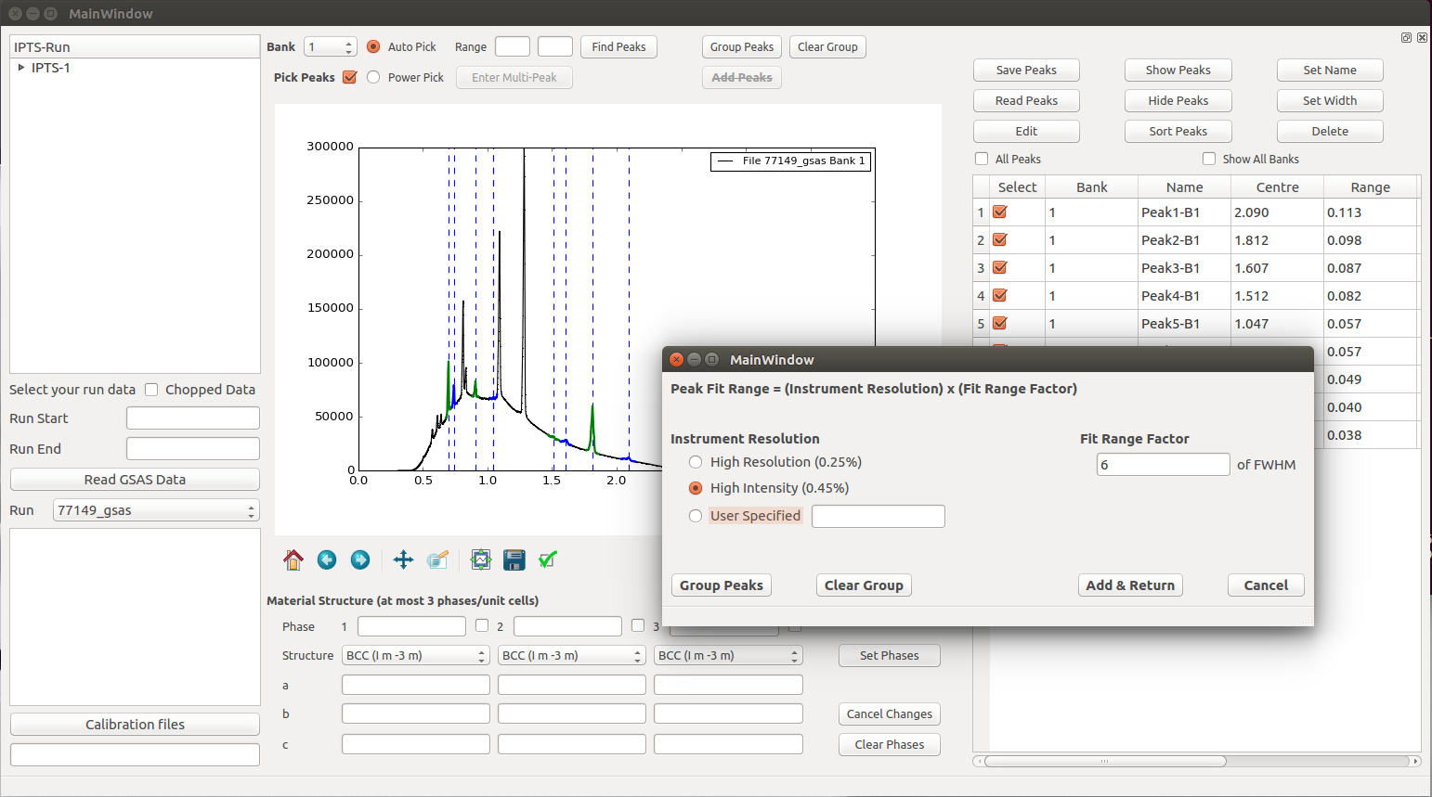
PyVDrive: Data Reduction for VULCAN
Details
Targets Routine Data Reduction
processing vanadium, single peak fitting, etc.
Simple Gui for new users
Vdrive commands implemented to ease transition from old code.
Facilitates complex filtering of event data.
Provides Ipython interface to python and Mantid to enable novel data reduction routines
Implements reduction off live stream
https://github.com/neutrons/PyVDrive
Embedded
IPython console
Event chopping
GUI
Single peak
fitting

Slide 9
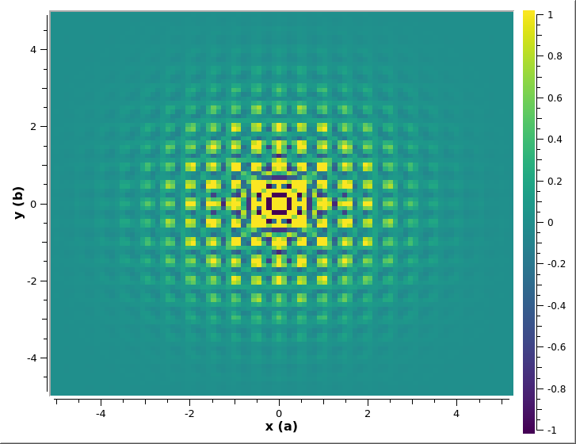
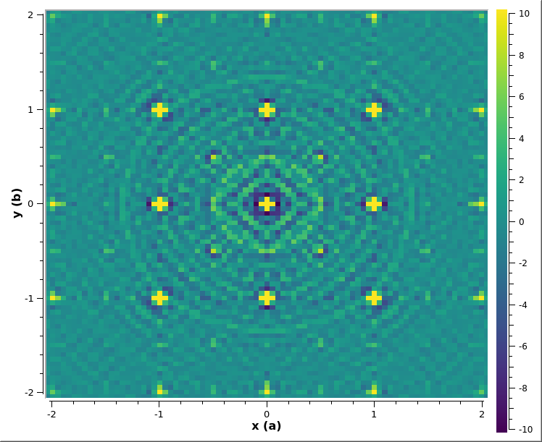
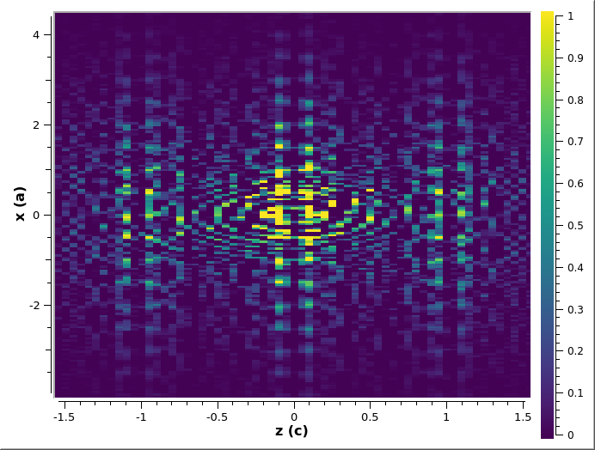
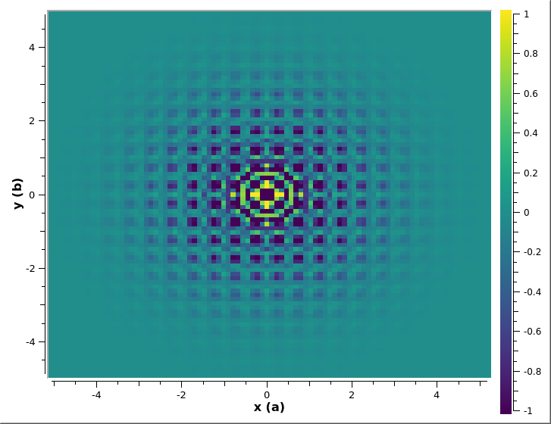
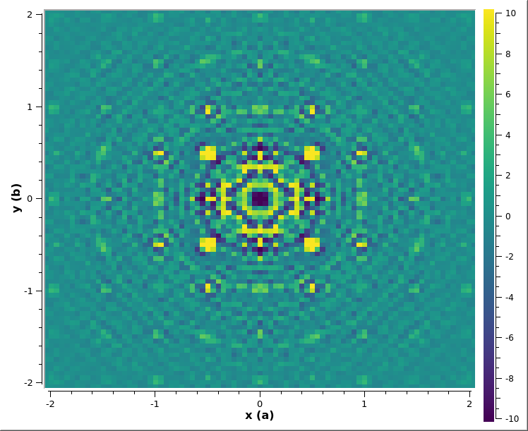
New algorithm for analyzing single crystal diffuse scattering Data added to Mantid
The algorithm generates the difference from the ordered structure pair distribution function (PDF) to highlight the diffuse scattering. Known as 3D-ΔPDF.
Used the punch-and-fill methods to remove the Bragg Peaks.
Ideas in collaboration with Argonne team
Tests of DTO and PMN confirm it works.
Reveals previously unknown pattern in Benzil.
Is available to users.
http://docs.mantidproject.org/nightly/algorithms/DeltaPDF3D-v1.html
DTO 680mK H=1.2T z=0
PMN 300K z=1
Benzil 300K, y=0.5
DTO 680mK H=1.2T z=0.25
PMN 300K z=0.5
Notes:
Benzil – IPTS-15526
DTO – Dy2Ti2O7 spin ice – IPTS-18149
PWN – PbMg(1/3)Nb(2/3)O3 ferroelectric perovskite – IPTS-16617

Slide 10
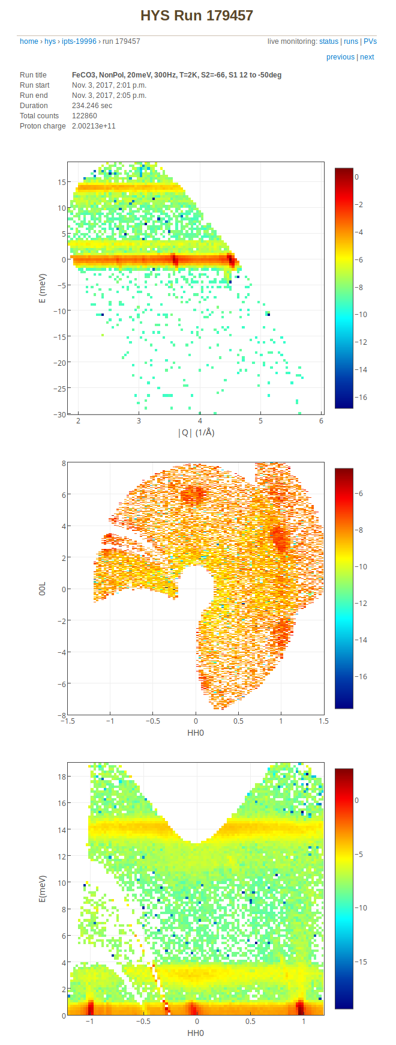
HYSPEC Auto reduction to data slices
Uses multiples runs
For single crystal data
Uses Mantid mutidimensional arrays and full normalization
Viewed in monitor.sns.gov
Expanding to other Direct Geometry Spectrometers
Notes:
Bottom left plot is from ARCS

